Slide 1
Here's your outline to get started
Key facts about your topic
Sports injuries are injuries that occur in athletic activities or exercising. In the United States there are about 30 million teenagers and children alone that participate in some form of organized sport. About 3 million avid sports competitors 14 years of age and under experience sports injuries annually, which causes some loss of time of participation in the sport. The leading cause of death involving sports-related injuries, although rare, is brain injuries. When injured the two main systems affected are the nervous and vascular systems. The origins in the body where numbness and tingling occurs upon sports injuries are usually the first signs of the body telling you that the body was impacted. Thus, when an athlete complains of numbness and especially tingling, the key to a diagnosis is to obtain a detailed history of the athlete’s acquired symptom perception, determine the effect the injury had on the body and its processes, and then establish the prime treatment method. In the process to determine what exactly happened in the body and the standing effects most medical professionals choose a method of technological medical devices to acquire a credible solu...
See more: Open the Notes below for more information.
Notes:
QuickStarter has created an outline to help you get started on your presentation. Some slides include information here in the notes to provide additional topics for you to research.
Summary:
Sports injuries are injuries that occur in athletic activities or exercising. In the United States there are about 30 million teenagers and children alone that participate in some form of organized sport. About 3 million avid sports competitors 14 years of age and under experience sports injuries annually, which causes some loss of time of participation in the sport. The leading cause of death involving sports-related injuries, although rare, is brain injuries. When injured the two main systems affected are the nervous and vascular systems. The origins in the body where numbness and tingling occurs upon sports injuries are usually the first signs of the body telling you that the body was impacted. Thus, when an athlete complains of numbness and especially tingling, the key to a diagnosis is to obtain a detailed history of the athlete’s acquired symptom perception, determine the effect the injury had on the body and its processes, and then establish the prime treatment method. In the process to determine what exactly happened in the body and the standing effects most medical professionals choose a method of technological medical devices to acquire a credible solution to the site of injury. Prevention helps reduce potential sport injuries. It is important to establish participation in warm-ups, stretching, and exercises that focus on main muscle groups commonly used in the sport of interest. Also, creating an injury prevention program as a team, which includes education on rehydration, nutrition, monitoring team members “at risk”, monitoring behavior, skills, and techniques. Season analysis reviews and preseason screenings are also beneficial reviews for preventing player sport injuries. One technique used in the process of preseason screening is the functional movement screen. The functional movement screen can assess movement patterns in athletes in order to find the at risk players. Following various researches about sport injuries shows that levels of anxiety, stress, and depression are elevated. A study in 2010 found that athletes with severe sports injuries would display higher levels of post-traumatic distress and the higher the levels of post-traumatic distress are linked with avoidant coping skills.

Slide 2
Related topics to research
Accident
Wounds
Penetrating trauma
Golfer's elbow
Ruptured spleen
Use Smart Lookup to learn more
1
Highlight one of the related topics
Right-click on the topic
Choose "Smart Lookup"
2
3

Slide 3
Introduction
Brief bio about myself and my practice
What shapes my current views on health/fitness and running
See the forest through the trees
Goals of the presentation
Embassy Suites by Hilton 1200 South Moorland Road Brookfield, WI 53005 (262) 782-2900
10am presentation

Slide 4
Injury Prevention for the High School XC Runner
Dr. Paul Krzesinski DC, ART

Slide 5
Today’s Objectives
Quickly screen runners for injury risk
Understand current core stability concepts and application for runners
Mobility drills to unwind the negative detriments of sitting in a classroom
Introduction to the “rotator cuff of the hip”
Stretching and foam rolling best practices
Self-care for shin splints

Slide 6
Perspective
See the Forest for the Trees
Notes:
Why are we here. I want to make sure we don’t lose perspective of what your role is as a coach. In the health care, sports and fitness arena I find too often we get lost in the details – putting too much emphasis on the small variables that are easily controlled in a laboratory setting and forgetting the big picture. This can be especially true for some of the more analytical minds. As we spend the next 40-45 minutes together lets make sure we see the forest for the trees and remember at the end of the day it’s important that we keep running fun.

Slide 7
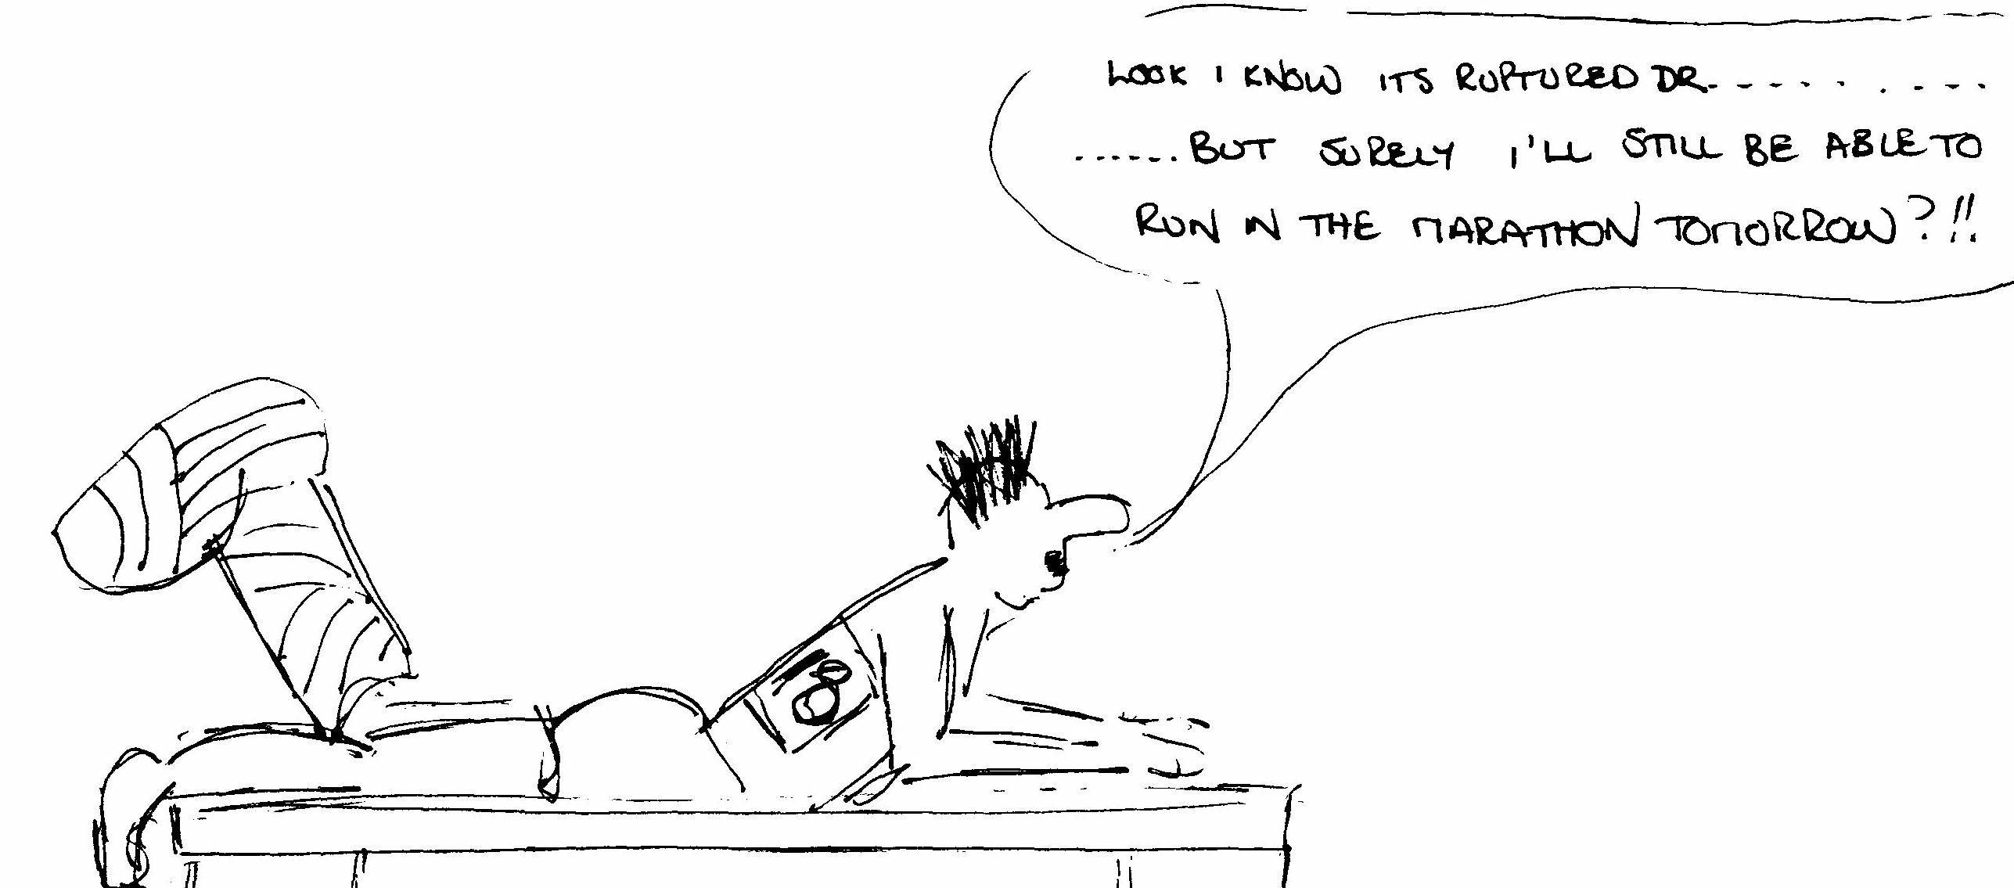
“running has a relatively high incidence of lower extremity injury, with the incidence ranging from 17.9-79.3%”
WHY????
1. Training Errors
2. Ground Reaction Forces (GRF)
Notes:
I want to simplify running injuries, the coach's role in preventing/causing injuries and hopefully dispel a few myths. You can spend a lifetime chasing the cause of injuries and two life times chasing the cure for injuries. Just look at the shoe industry itself – we’ve done a complete 180 over the past 40 years from the well cushioned Nike Air Max to the barefoot/minimalist phase and now we are back to minimal heel rise with loads of cushioning found in the Hoka brand. Somewhere in the middle is where the truth lives.
The reality is successful running can be predicted by looking at two questions.
How good is your training
How successful do you absorb ground reaction forces.

Slide 8
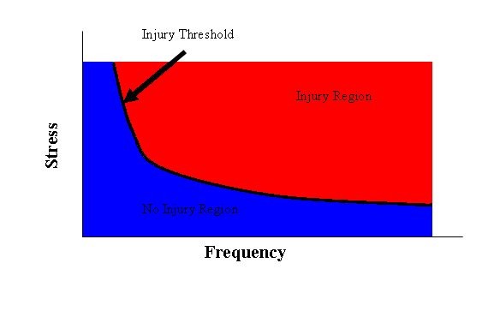
Training Errors
Notes:
The simple goal of any training plan is to balance the relationship between load and capacity. Ideally, give an athlete as much load as he/she can handle without injury and allow a physiological training adaptation to occur before increasing the load. Physiological principles of training that are consistent for each individual. Challenge of the high school coach to balance a stress/compensation variables that must abide by the underlying principals but are uniquely characteristic to the individual athlete that only a dressing the factors mentioned earlier but also nonphysical stressors and motivational differences are found within the variable ranges of high school athlete’s.
Illness, injury and poor performance are all symptoms of exceed the injury threshold/over training.

Slide 9
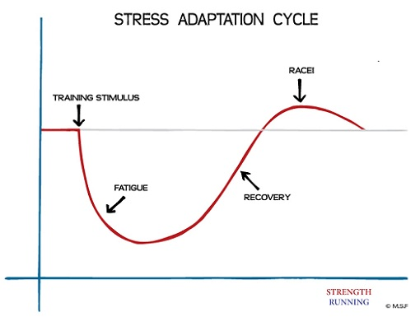
Notes:
Hans Selye’s original work on stress adaptation; endocrinologist. Identified the HPA axis (Hypothalamus-Pituitary-Adrenal axis)

Slide 10
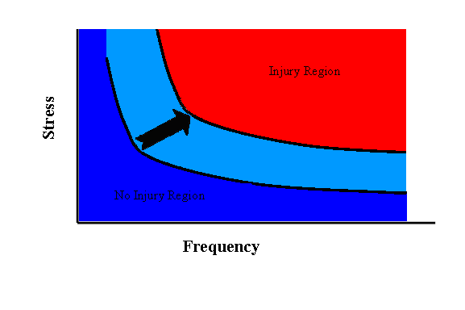
Training Effect
Notes:
What can we do as coaches to maximize training effect and minimize Injury??? Factors that we cannot control (structural challenges, motivation, diet, recovery methods, etc. ) Factors that we can control (training methods, education, positive environment).

Slide 11
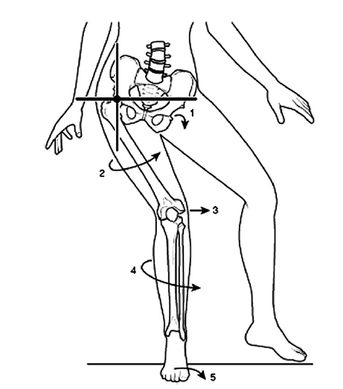
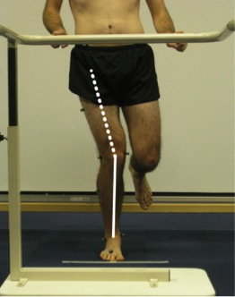
Ground Reaction Forces
Each foot strike results in absorption of 2-7x body weight
Pronation is how the body absorbs GRF
Series of predictable joint movements and muscle contraction of the entire lower extremity
What happens when an athlete is not effective at pronation??
Notes:
Slow motion image of foot striking ground to offer a visual representation of the violent nature of GRF’s – 2-7x bodyweight per foot strike

Slide 12
Screen Athletes Quickly and Effectively
BW Squat
Single Leg squat
Observation

Slide 13
Body Weight Squat
A primal movement pattern that can quickly assess the natural ability to act as a spring (i.e. absorb GRF)
Foot/Ankles
Knee Position
Hip Flexion
Mid Back (Thoracic Spine)

Slide 14
Body Weight Squat
Notes:
The body weight squat is an authentic movement pattern that you can easily use to screen a runners ability to control pronation – or how effectively does the spring absorb ground reaction forces. Key things to pay attention to – ankles
-Consider using a volunteer from audience to demonstrate the squat and squatting with heels elevated

Slide 15
Single Leg Squat
Running is as simple as balancing one foot. . . Over and over again.
SL Squat is a more complex way of assessing how an athlete can control pronation of the lower extremity.
Foot/Ankle
Knee
Pelvis
Notes:
Talk about how I can easily screen a runner in the clinic by having them stand on one foot and raise the opposite knee.
“speed hides dysfunction”

Slide 16
Observe your Runners
Assess Running gait
Naked Eye
Picture/Video
What to look for
Foot Strike
Knees crossing midline
Pelvis Drop
How do you use this information as a coach?
Hard day become an easy day?
Art of coaching

Slide 17
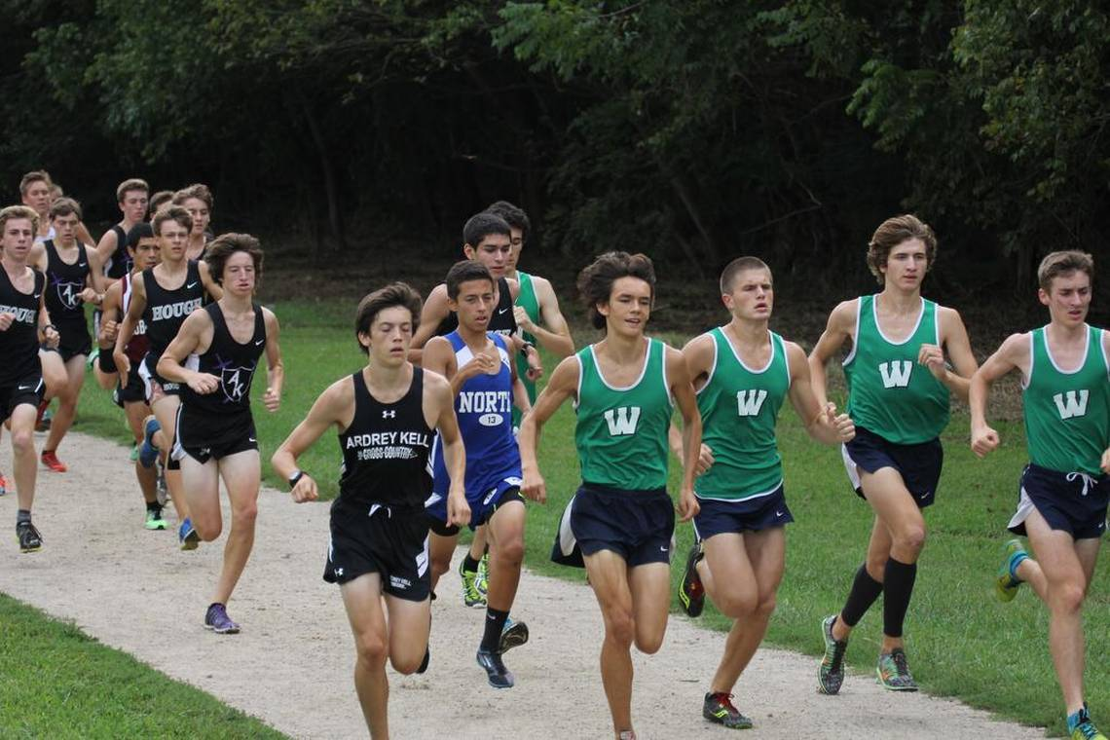
Notes:
Quickly and effectively screening athletes is the first step to identify inefficiencies in the ability to absorb GRF.

Slide 18
Rotator Cuff of the Hip
Notes:
Pitch counts for youth throwers and RC exercises that are widely incorporated and accepted with good success. Can the same be said for the deep musculature of the hip – a primary weight bearing joint.

Slide 19
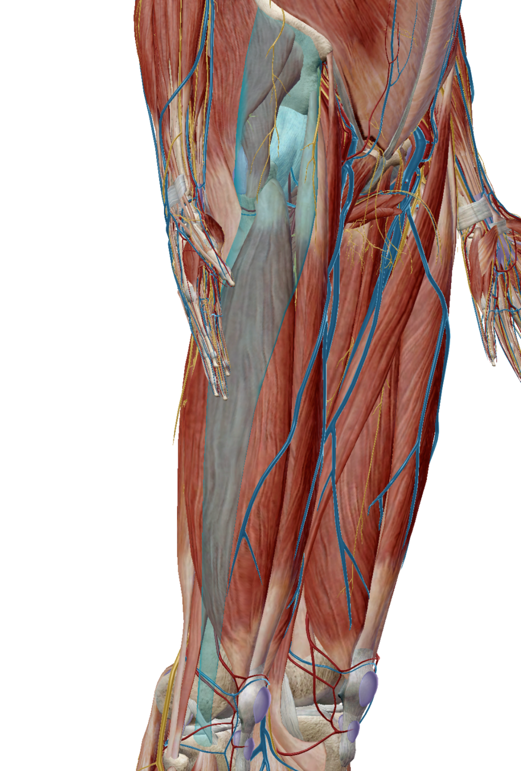
Rotator Cuff of the Hip
Gluteus Medius/Minimus and Gluteus Maximus
Functional Anatomy
Abduct and Extend the hip
stabilize pelvis during single leg activities
Control lower extremity PRONATION
Research has demonstrated that abnormal hip function is related to a number of lower extremity and low back conditions.
There is a simple explanation why our hip function in society is so poor . . . You are sitting on it.
Notes:
Emphasize the importance of the hip as it relates to running performance, healthy aging, reducing orthopedic health care expenses.
Talk about knee joint being the middle child.

Slide 20
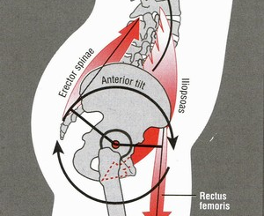
Lower Crossed Syndrome
Prolonged periods of sitting results in a very predictable pattern of muscular weakness and tightness that can result in an abnormal pelvic posture.
Weak/Inhibited = glutes, abdominals,
Tight/Overactive = Iliopsoas, quadriceps, erector spinae
This is why so many people have tight hamstrings that don’t respond to stretching – because they are not tight but weak – especially in runners. Fix the muscular imbalances of the pelvis and tight hamstrings magically disappear.
Notes:
Crossed Syndromes first identified by Professor Vladimir Janda and Lewit
Reciprocal Inhibition –shortening/contraction of a muscle group will cause the antagonist (opposite) muscle group to relax.

Slide 21
Hip Smash
Simple but effective form of reducing trigger points using a technique called Ischemic Compression
Lacrosse Ball fits perfectly in the space above the greater trochanter
Relaxing is key – should feel Trp’s “melt away”
20-60 seconds per side 1x per day
Notes:
Alternative is a tennis ball or wearing heavy pair of sweat pants. Want to do this first after a warm up but before doing other exercises.

Slide 22
Hip Flexor Stretch
Start in a half kneeling position with narrow base of support.
Tuck the pelvis/posterior tilt
Squeeze the glutes
Hold 5 secs and repeat 5x per side
Notes:
There are many variations of this stretch that you can use. I prefer to start with a half kneeling position because it is easier to get into a neutral pelvic position because less energy is being spent supporting the body in a standing position.

Slide 23
Clam Exercise
Highest GTA Index 87.89
Purpose: Activation of Glutes without activating TFL
Pelvis should not rotate
Press down side knee into ground to increase activation
2-3 sets of 15 reps
Notes:
GTA index (Gluteal to TFL muscle activation); This is not range of motion exercise – the ROM is the ROM and it is not the goal of this exercise to increase external rotation.
If you choose to use a resistance band a green (men) or red (women) band is best respectively. Too much resistance defeats purpose of exercise. Emphasize slow, smooth, and controlled movement.

Slide 24
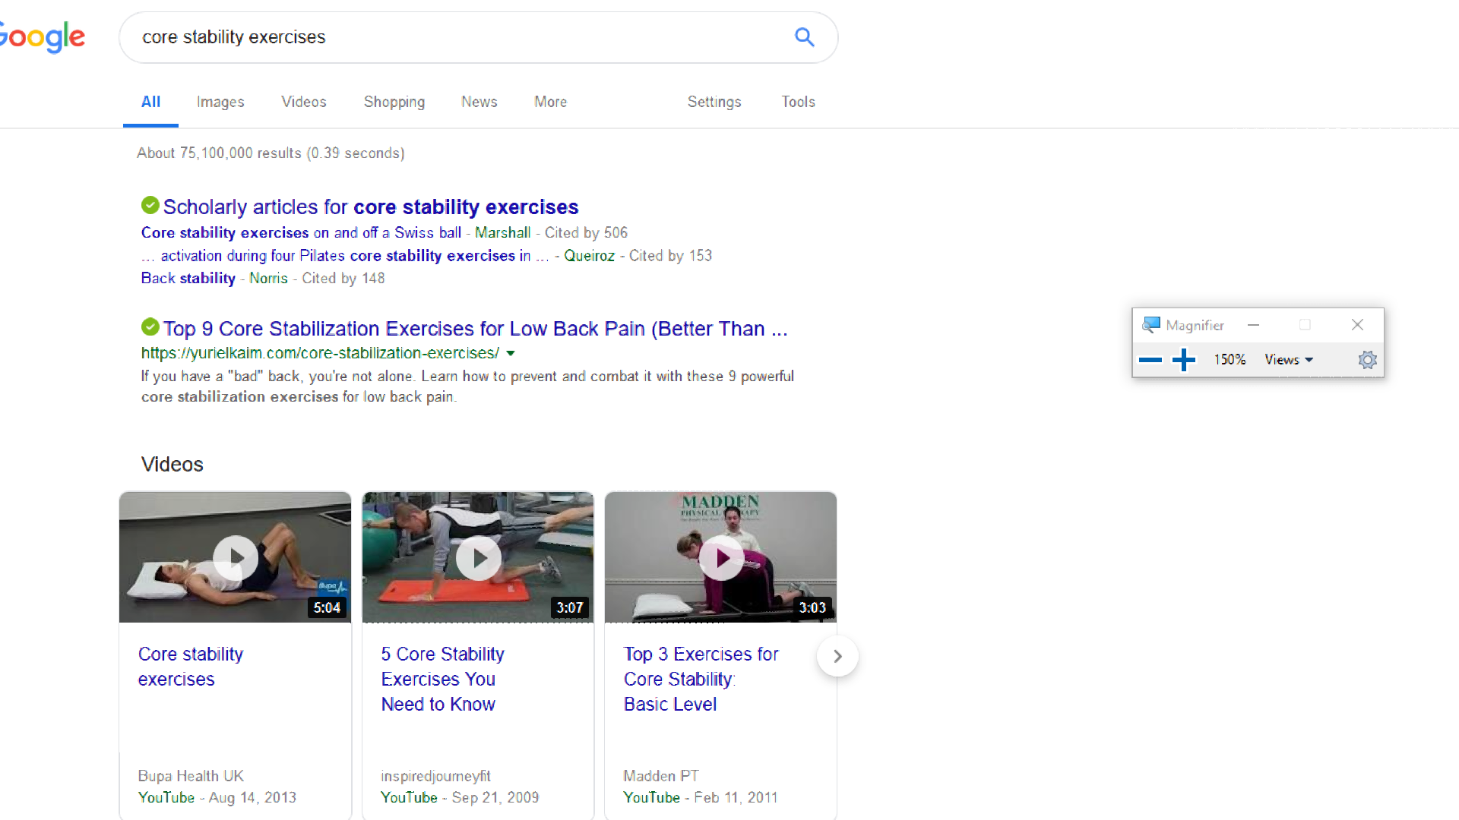
Core Stability

Slide 25
Core Stability
“Dynamic neuromuscular (core) stability is necessary for optimal athletic performance and is not achieved purely by adequate strength of abdominals, spinal extensors, gluteals or any other musculature; rather, core stabilization is accomplished through precise coordination of these muscles and intra-abdominal pressure regulation by the central nervous system.”
Frank C, Kobesova A, Kolar P. Dynamic Neuromuscular Stabilization & Sports Rehabilitation. The International Journal of Sports Physical Therapy. 2013;8(1): 62-73.

Slide 26
Core Stability
You Don’t own a position until you can breathe in it –Gray Cook
Notes:
Loss of spinal stability results in up regulation of muscle tone to stabilize joints I.e. Trigger points
Trigger point is the brains way of stabilizing a region, occurs in a systematic and predictable pattern
Breathing Pattern test –
Sitting – one hand on chest, one hand on abdomen – normal breath in. Which hand moves the most? – if what was your belly hand stand up.
Standing test – fingers on top of iliac crest – normal breath in – can you feel your breath at your fingers.

