Slide 1
Factors associated with poor respiratory patterns
Suboptimal Respiration and Posture
Decreased ZOA of Diaphragm
Decreased exercise tolerance
Decreased intra-abdominal pressure
Shortness of Breath/Dyspnea
Decreased Respiratory efficiency
Decreased expansion of lower rib cage
Increased use of accessory muscles of respiration
Poor neuromuscular control of core muscles
Increased lumbar lordosis
Increased anterior pelvic tilt
Increased hamstring length
Increased abdominal length
Rib Elevation
Sternum elevation
Increased activity of paraspinals
Increased lumbar-pelvic instability
Low back pain
Sacroiliac joint pain
Thoracic outlet syndrome
Headaches
Asthma
Sports Hernia
Inguinal Hernia
Neck Pain
Hand numbness/Tingling
Scapular Instability

Slide 2
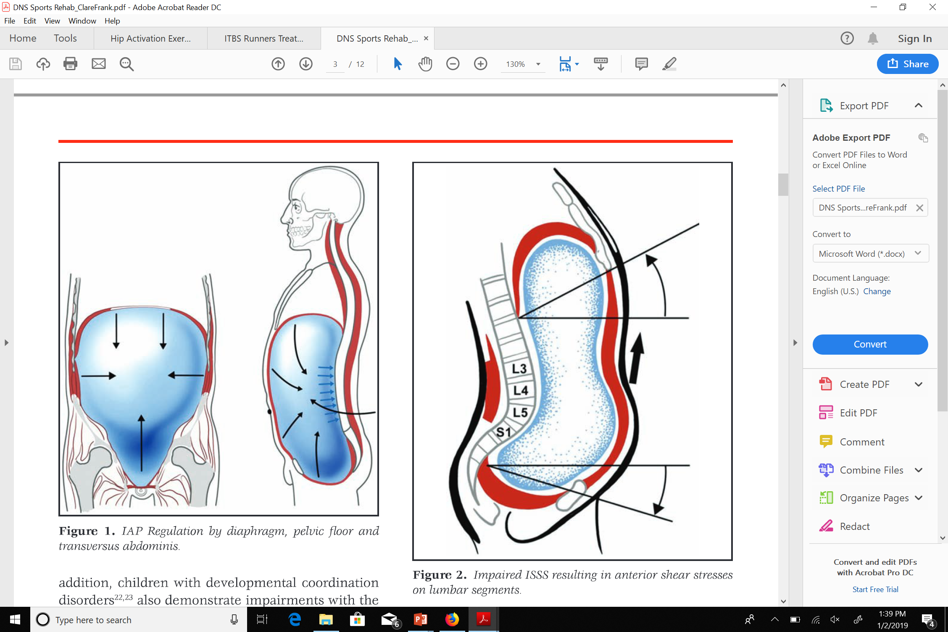
Notes:
Obtaining the proper lumbar position is an important component of getting the diaphragm to function properly. If you don’t have a good position you will never be successful at breathing/core stability.

Slide 3
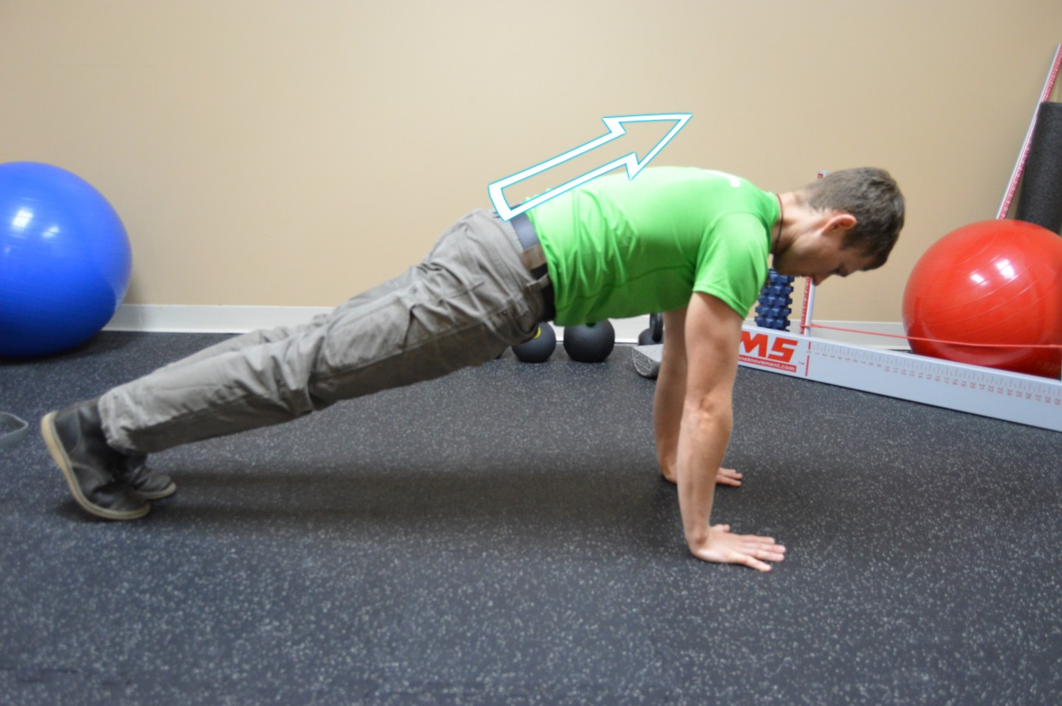
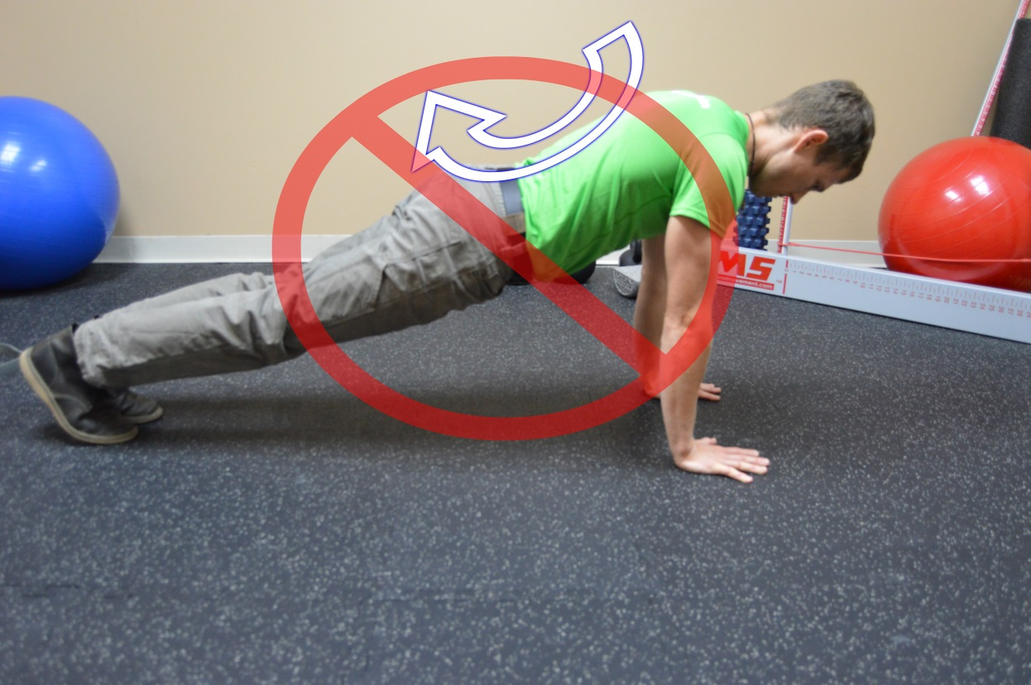
Core Stability
Plank with Core
Plank without core

Slide 4
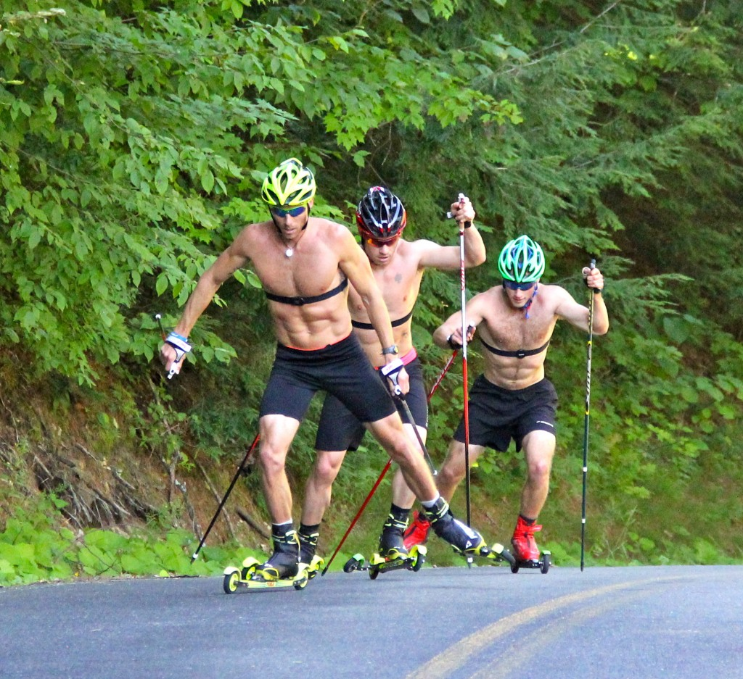
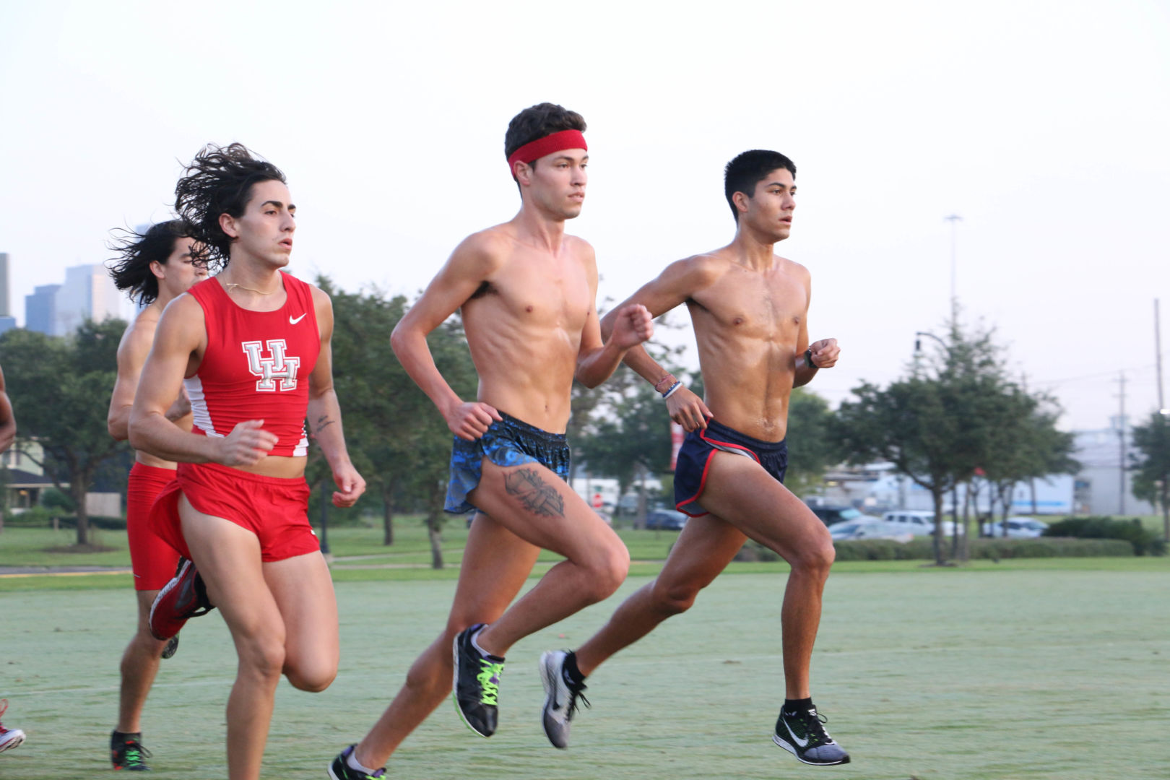
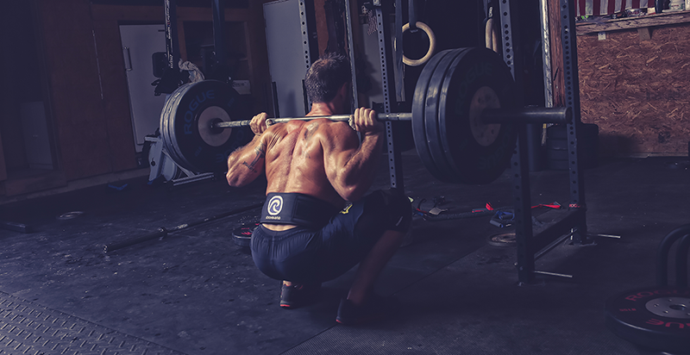
Notes:
Examples of athletes that have adequate core stability during their respective sport; level pelvis and abdomen is not hollowed.
Kris Freeman roller skiing, collegiate cross runners, rich froning

Slide 5
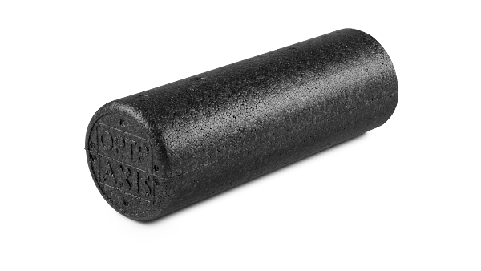
Best Practices for Foam Rolling and Stretching
Foam Roll –
  Thoracic Spine –
  Quadriceps/IT Band – plank position
    Two legs, 1 leg w/support, 1 leg, 1 leg w/knee flexion
  Anterior Shin
Calf Smash

Slide 6
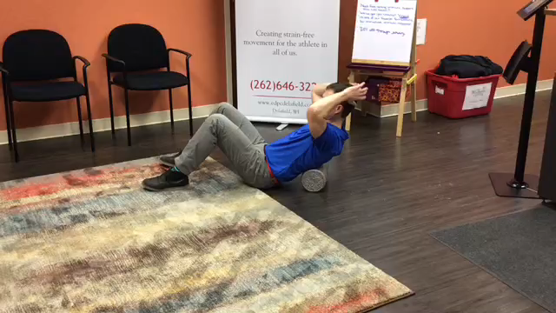
Foam Rolling – Thoracic Spine
T/S Hypomobility is directly tied to a dysfunctional breathing pattern
Reduce anterior head posture
Portable Chiropractor
3-5x per day 20-30 secs
Notes:
Hardest part is getting on and off the floor; will improve squat pattern, shoulder function and reduce the anterior head posture.

Slide 7
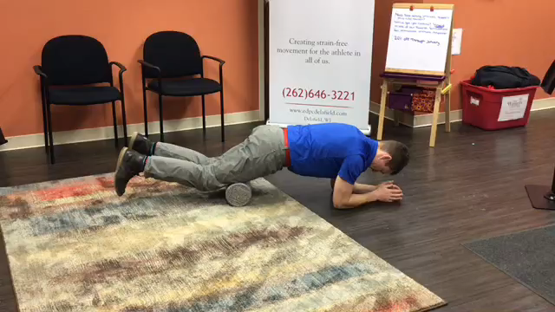
Foam Rolling Quads
Active Plank Position (avoid anterior pelvic position)
Progression of increasing intensity
  Two legs =>1 leg w/support => 1 leg=> 1 leg w/knee flexion
Best to perform this after a warm up or workout.
Notes:
My personal opinion is it can help “flush out inflammation” by increasing circulation; help to inform an athlete about state of recovery of quadriceps; can be a away of performing a “functional plank”. Some research suggest that foam rolling lightly before bed may increase the parasympathetic nervous system and help with a more restful nights sleep.

Slide 8
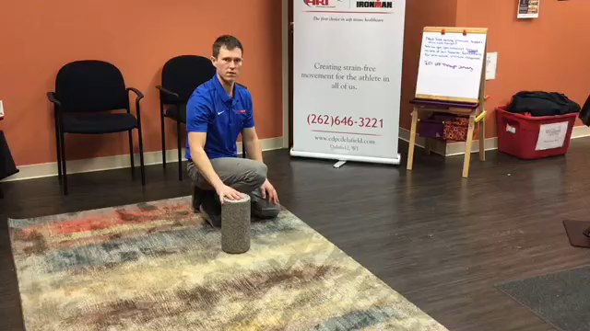
Foam Rolling Anterior Lower Leg
Tibialis Anterior, Flexor Hallux Longus, Flexor Digitorum Longus
Ease the transition from training flats to racing flats/spikes
Shin Splints

Slide 9
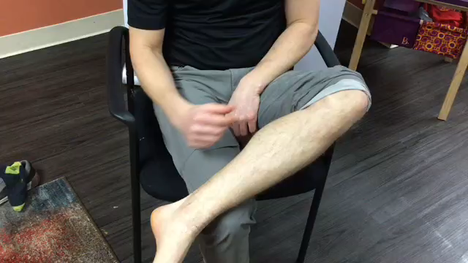
Calf Smash
Self Massage Trp’s and adhesion of the deep muscles of the calf
Deep compartment of calf (PT, FHL, FDL) play a primary role in controlling foot pronation
Largely responsible for Shin Splints and stress fractures
Notes:
This is one of my favorites because it easy to implement and the results are immediate.

Slide 10
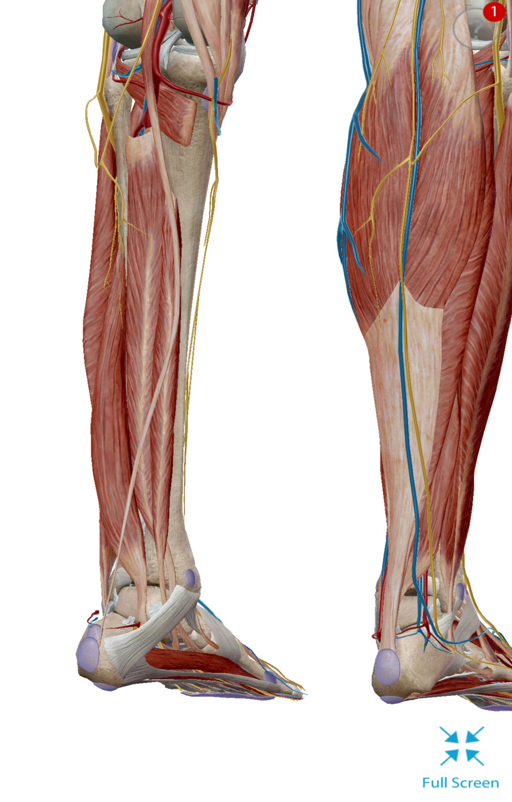

Slide 11

Take Home Points
Attack the Texas size dysfunction
Recommend Appropriate Footwear
  Train in your racing flats
K.I.S.S Method
Dr. Paul’s Top 3
Hip Flexor Stretch
Hip Smash
Clam Exercise
Breathing

Slide 12
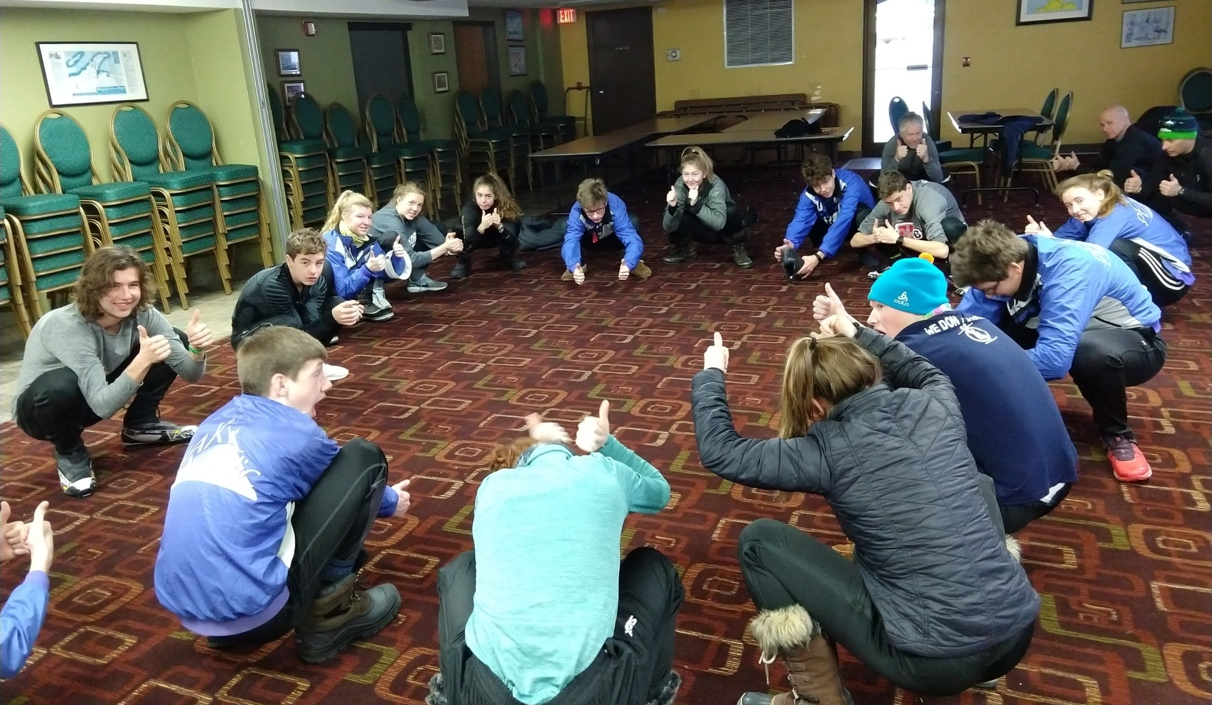
Strategies for Success
Warm-up
  Squat 5-10
  Hip Flexor Stretch
  Core Stability
  Crawling Movement
  Squat 5-10
Workout
Cool Down
  Foam Roll
    Mid Back, Quads, Shin
  Lacrosse ball
  Clam Exercise 3 x 15
  Stretching
Notes:
-add a link for Peak Nordic Skiers Moblity workout

Slide 13
Mobility/Recovery Workout
Warm Up – 5-10 minutes easy run
BW Squat . . . . . . . 5 reps
Overhead BW Squat . . . . . . . 5 reps
Foam Roll –
Mid Back . . . . . . 1 min
Right Leg . . . . . . . . 1min
Left Leg . . . . . . . . . 1 min
Shin Smash . . . . . 1 min
Bird Dog 3x10 ea. Leg
Plank 45 -90 sec
Lacrosse Ball –
Right Hip Smash . . . . 1 min
Left Hip Smash . . . . 1 min
Clam Exercise 3 x 15 ea leg. . . slow, don’t let pelvis rotate
Mountain Climber 10 ea leg
** slow. . . . how you transition between legs is the important part
Calf Smash . . . . 1-2min per leg
Downward Dog Heel Touches 10 ea leg
Prying Goblet Squat
5x10 Push ups on the minute
BW Squat. . . . . . . . 5 reps
Overhead Squat . . . . . . 5 reps
Notes:
i.e. optional relay
- crawling (hands and toes) and crab walk
Split team into Group A and Group B. Group A does an easy 30 minute run, Group B is split into Foam Roll Group and Lacrosse Ball Group. Perform BW squats together as group and then groups separate and perform ½ mobility workout for 10 minutes and switch.
At end of workout whole team can do relay races together.

Slide 14

Good Luck in 2019!!
Dr. Paul Krzesinski DC, ART™
2574 Sun Valley Drive #206
Delafield, WI 530128
262-646-3221
www.epcdelafield.com
paul@epcdelafield.com

