Slide 1
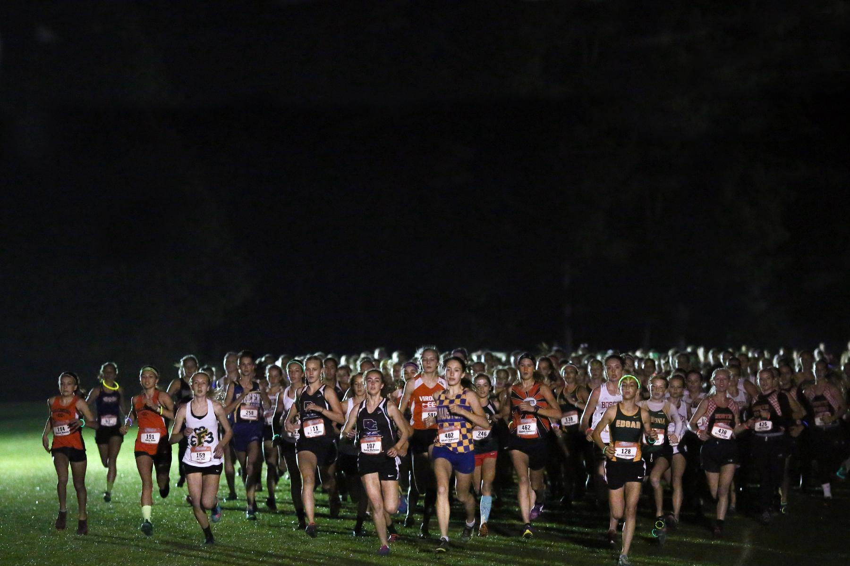
Goal Setting and other Whippet Program Insights
Chad Carstens
Whitewater High School
ccarstens@wwusd.org

Slide 2
Goal Setting - why?
- Provides direction
- Gives focus to what we are doing
- Allows time for perspective
- Fosters the relationship between athlete and coach
- Gives long term vision with short term motivation

Slide 3
Goal Setting - 3 components
What motivates you?
Team goals
Individual goals
*Team and individual goals must be specific and measurable

Slide 4
Goal Setting - 3 components
What motivates you? Coach...what do you mean?!
Notes:
What’s your “why”?

Slide 5
Goal Setting - 3 components
What motivates you? Coach...what do you mean?!
When an athlete can identify truly what motivates them, it really opens their minds to WHY they run, and the purpose of their goals. It gives direction.

Slide 6
Goal Setting - 3 components
What motivates you? Coach...what do you mean?!
Examples: staying healthy and fit, being a leader, family, teammates, faith, winning, competition

Slide 7
Goal Setting - 3 components
List one team goal that is specific and measurable for the season.
weak - Finish higher than last year at conference

Slide 8
Goal Setting - 3 components
List one team goal that is specific and measurable for the season.
weak - Finish higher than last year at conference
strong - Place in the top 3 because last year we finished 4th.

Slide 9
Goal Setting - 3 components
List THREE individual goals that are specific and measurable for the season.
weak - be a better teammate.

Slide 10
Goal Setting - 3 components
List THREE individual goals that are specific and measurable for the season.
weak - be a better teammate.
strong - i will give high fives to a minimum of 5 teammates at the end of each practice.
Another one? Organize 2 team bonding activities.

Slide 11
Goal Setting - 3 components
List THREE individual goals that are specific and measurable for the season.
weak - drink more water

Slide 12
Goal Setting - 3 components
List THREE individual goals that are specific and measurable for the season.
weak - drink more water
strong - i will consume one bottle before lunch and one before practice each day

Slide 13
Goal Setting - 3 components
List THREE individual goals that are specific and measurable for the season.
weak - run faster than last year

Slide 14
Goal Setting - 3 components
List THREE individual goals that are specific and measurable for the season.
weak - run faster than last year
strong - Earn all conference honors in the RVC

Slide 15
Goal Setting - Additional Thoughts
Athlete: “I just don’t want to be as competitive, I need to find the ‘fun’ in cross country like it was the first two years - when it’s fun the work gets done right. I would like to end my season on a good note.”
Notes:
Focus on the process.”

Slide 16
Goal Setting - Additional Thoughts
Feedback solicited from athletes:
In end-of-year feedback form I ask….
  Did you have any goals for this season?
  Did you accomplish these goals?
  If so, what helped you accomplish them?
  If not, what stood in your way?
Notes:
Focus on the process.”

Slide 17
“I have an eating disorder and my mom doesn’t know.”

Slide 18
“I was hungry constantly.”

Slide 19
Advice from a former athlete
Get girls to “buy in” - look at examples of strong women doing it the right way.
EX: Lauren Fleshman, Allie Kieffer, Anna Rohrer

Slide 20
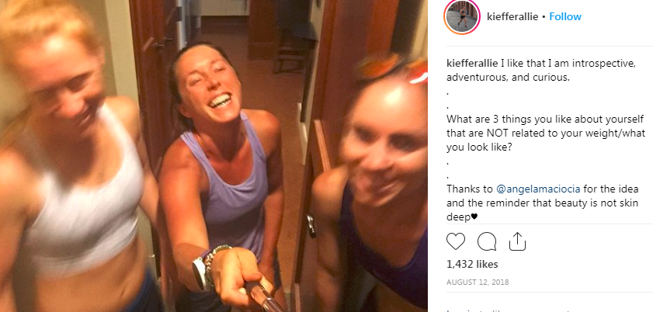

Slide 21
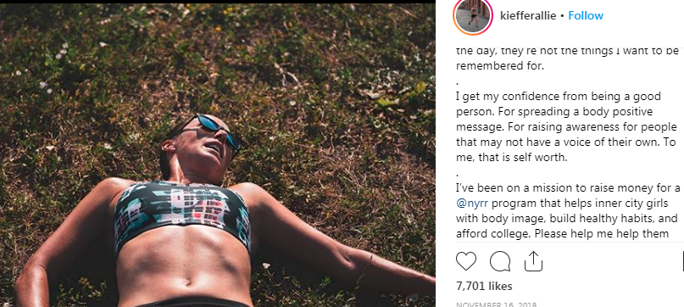

Slide 22
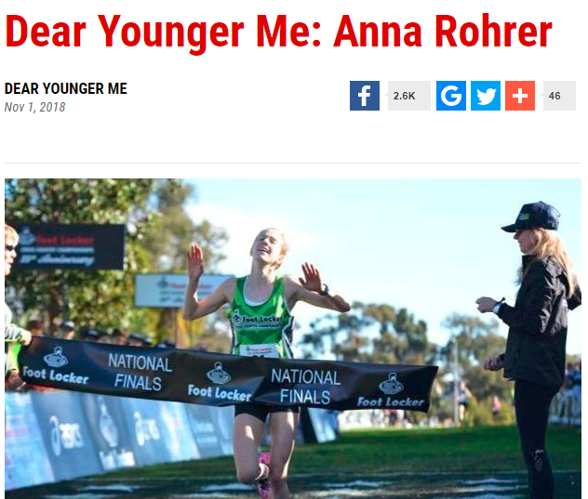

Slide 23
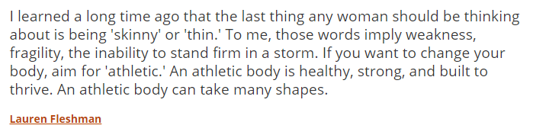

Slide 25
Advice from a former athlete
Get girls to “buy in” - look at examples of strong women doing it the right way.
EX: Lauren Fleshman, Allie Kieffer, Anna Rohrer
2) Watch your athletes…”salad from home or salad bar only is a big sign.”

Slide 26
Advice from a former athlete
Get girls to “buy in” - look at examples of strong women doing it the right way.
EX: Lauren Fleshman, Allie Kieffer, Anna Rohrer
2) Watch your athletes…”salad from home or salad bar only is a big sign.”
--------------------------------
3) Talk to resources available to you (school counselor, social worker, trainer, administration, etc)

Slide 27
Advice from a former athlete
Get girls to “buy in” - look at examples of strong women doing it the right way.
EX: Lauren Fleshman, Allie Kieffer, Anna Rohrer
2) Watch your athletes…”salad from home or salad bar only is a big sign.”
--------------------------------
3) Talk to resources available to you (school counselor, social worker, trainer, administration, etc)
4) Be ready to talk to the family, too.

Slide 28
Fundraisers in Whitewater
Mow-A-Thon
Water Softener SAlt
Meat Raffle
t

Slide 29
Mow-A-Thon

Slide 30
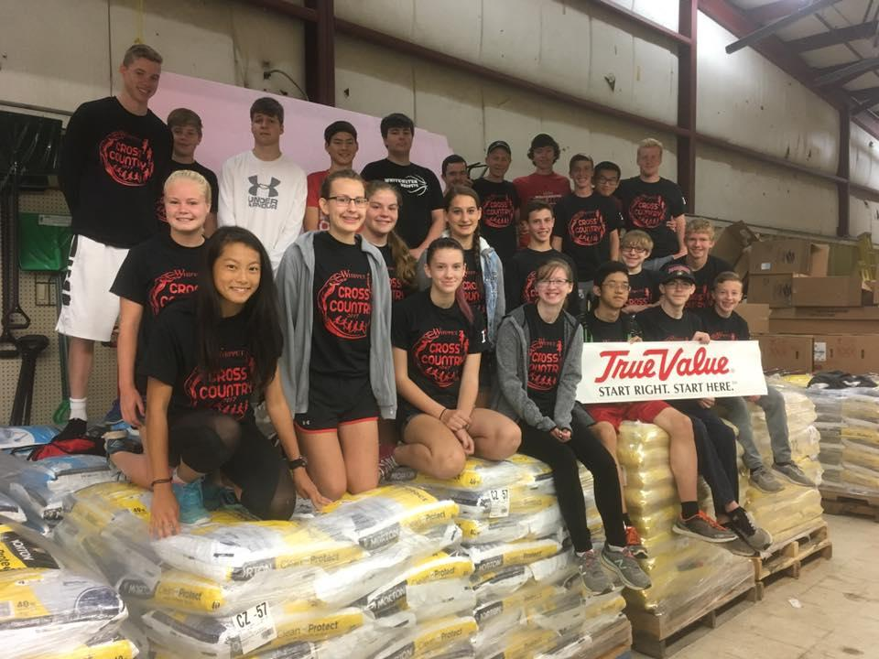
Water Softener Salt

Slide 31
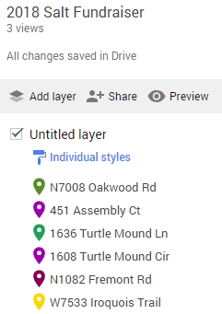
Mow-A-Thon & Water Softener Salt
Plot them on a google map

Slide 32
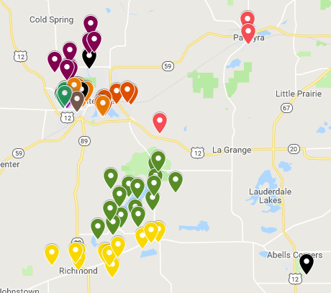
Mow-A-Thon & Water Softener Salt
Plot them on a google map

Slide 33
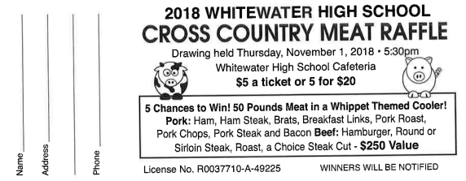
Meat Raffle
Meat Raffle Flier

Slide 34
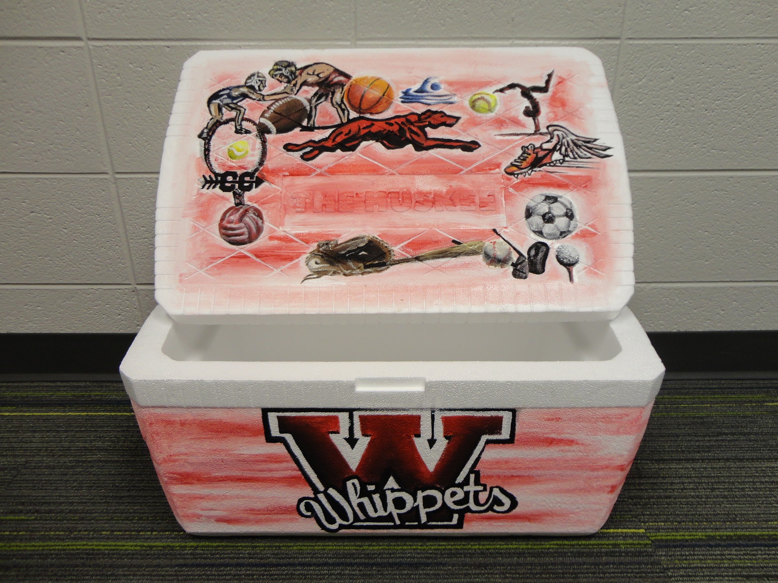
Meat Raffle
Meat Raffle Flier

Slide 35
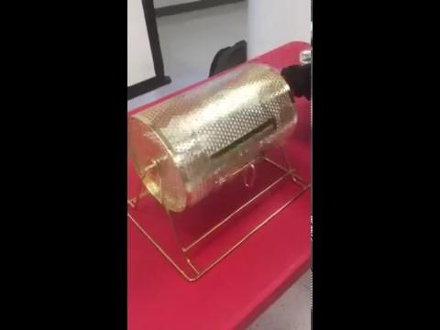
Meat Raffle
Meat Raffle Flier

Slide 36
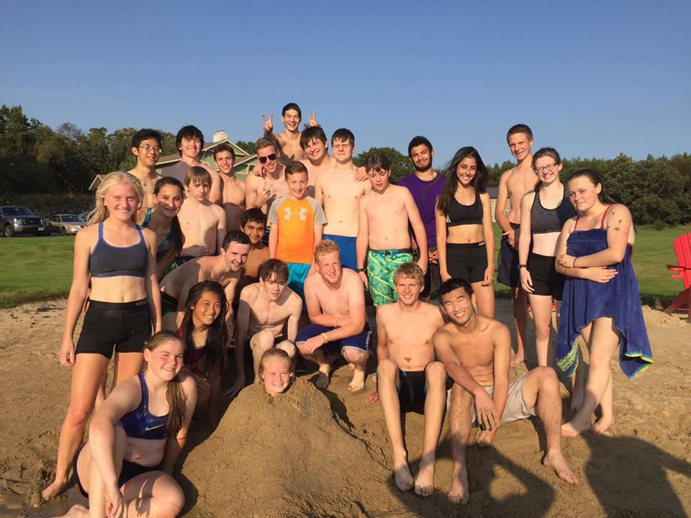

Slide 38

Splash
Meat Raffle Flier

Slide 39
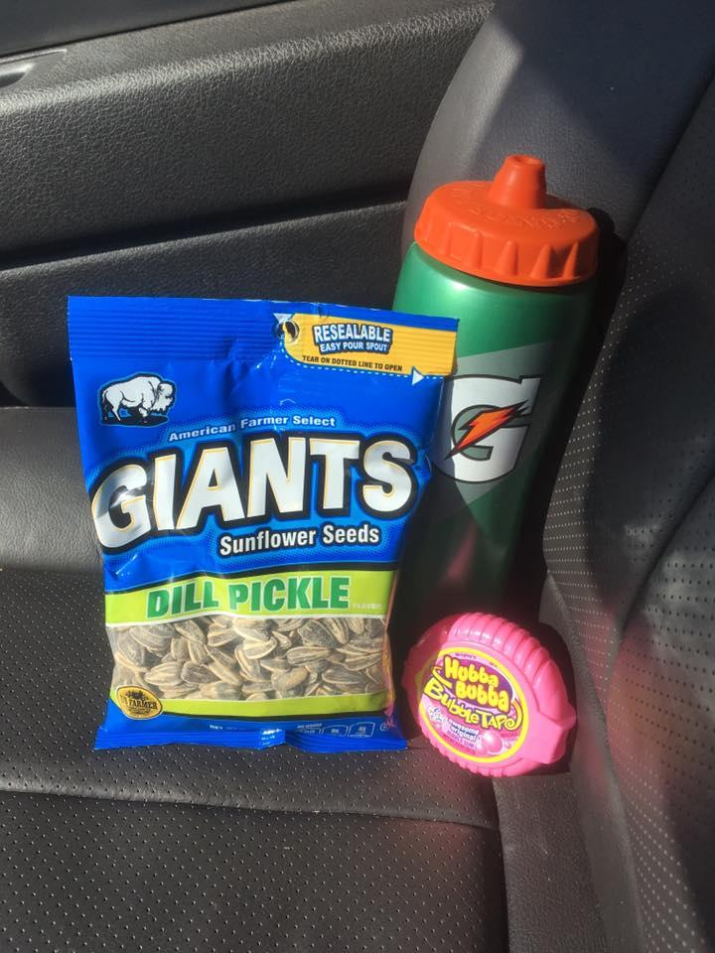

Slide 40
“You only get one piece”

Slide 43
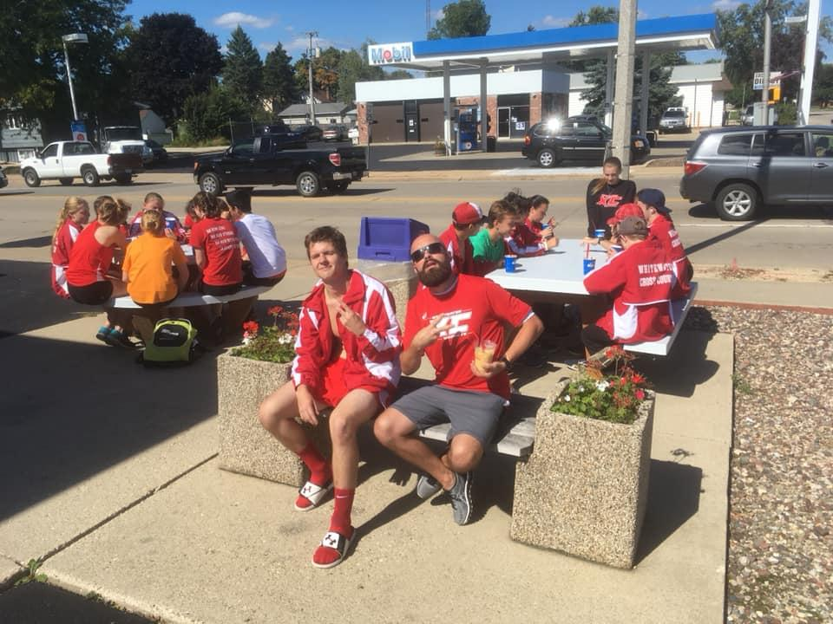

Slide 44
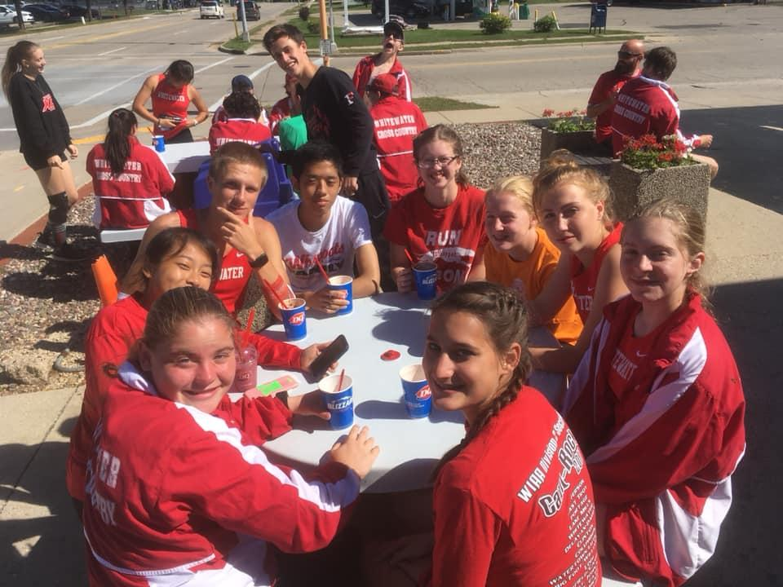

Slide 45
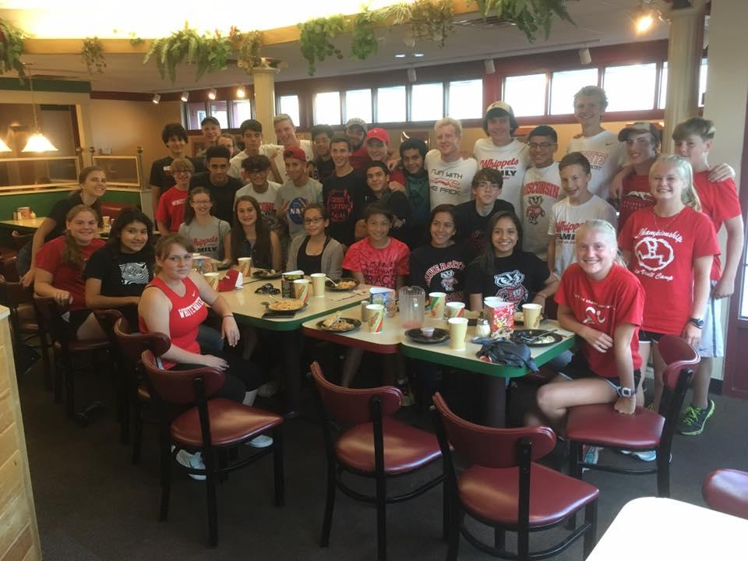

Slide 46
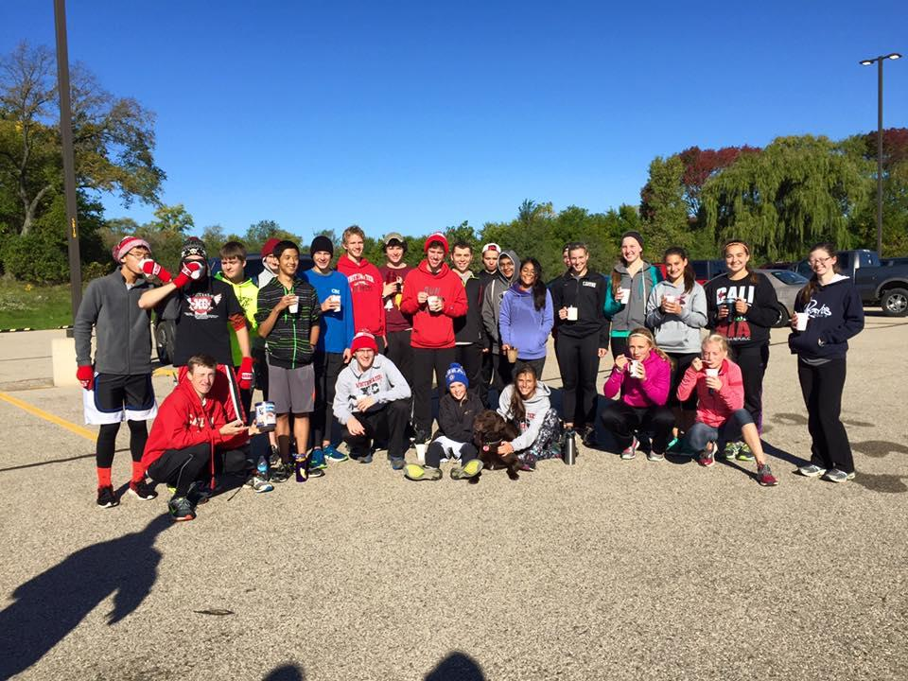

Slide 47
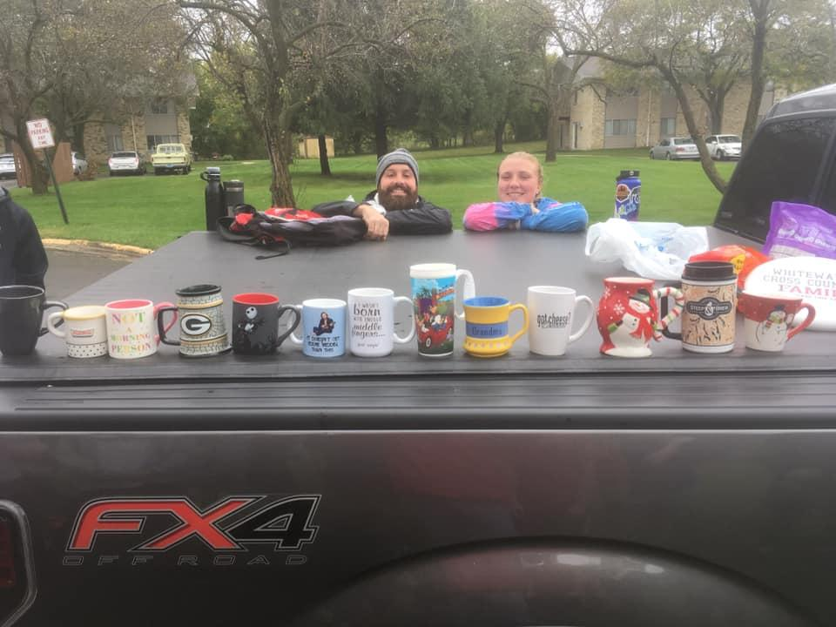

Slide 48
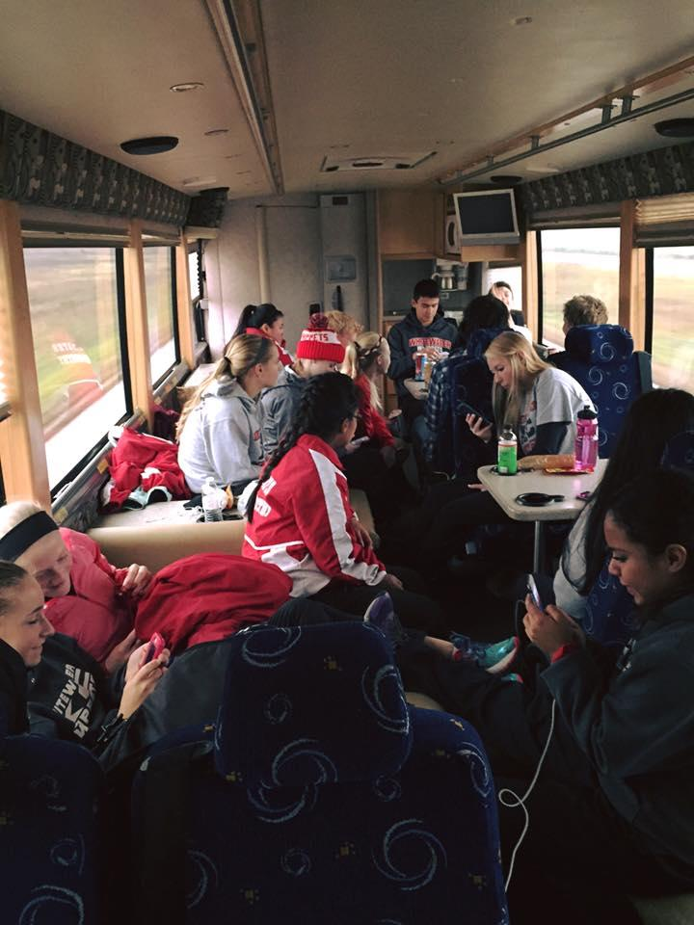

Slide 49
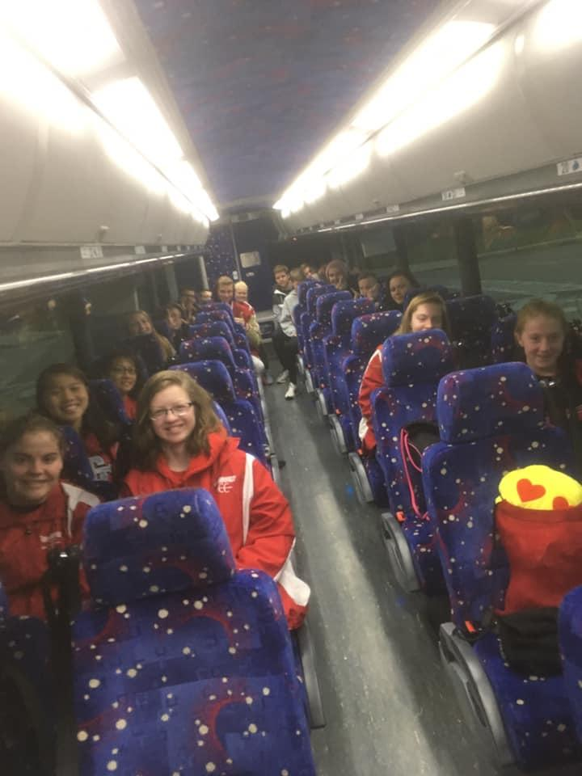

Slide 50
What else do we do?
Weekly team meetings
Visualizations
t

Slide 51
CCARSTENS @
WWUSD.ORG
t

